Slide 1
AKHUWAT MODEL --- AN INNOVATIVE APPROACH
By: Syed Hussain Haider
Director, Akhuwat Institute of Social Enterprise and Management
CSO, Akhuwat Education Services
Adjunct Faculty, LUMS

Slide 2
Principles
Use of indigenous institutions like mosque and church
Volunteerism & Reliance on civil society
Interest free loans (Qard-a-Hassan)
Converting borrowers into donors
Serving of Humanity

Slide 3
Akhuwat’s Innovative Projects
Akhuwat Interest Free Micro Finance (AIM)
Akhuwat Education Services (AES)
Akhuwat Education and Assistance Program
Akhuwat FIRST
Akhuwat University
Akhuwat College
Akhuwat Schools Project (ASP)
Akhuwat Leadership and Fellowship Program
Akhuwat Institute of Social Enterprise and Management

Slide 4
Akhuwat’s Innovative Projects
3. Akhuwat Health Services (AHS)
4. Akhuwat Clothes Bank (ACB)
5. Akhuwat Khuwajasira Support Program (AKSP)
6. Akhuwat Dreams Project

Slide 5
2. Akhuwat Education Services
Akhuwat Education and Assistance Program (AEAP)
Akhuwat FIRST
Akhuwat University
Akhuwat College
Akhuwat Schools Project (ASP)
Akhuwat Leadership and Fellowship Program (ALFP)
Akhuwat Institute of Social Enterprise and Management (AISEM)

Slide 6
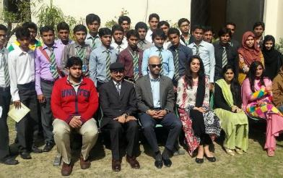
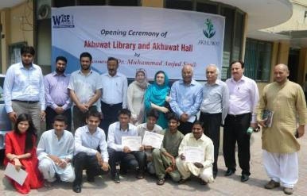
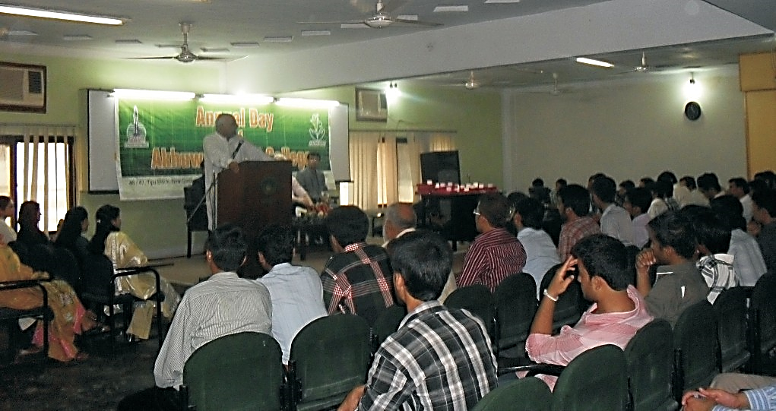
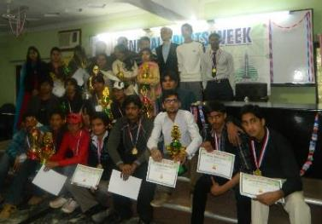
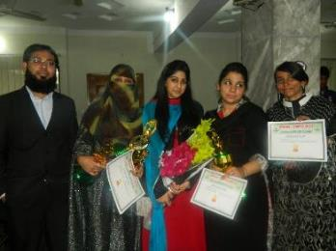
A) Akhuwat Education Assistance Program

Slide 7
B) Akhuwat FIRST
Conducting BS (Hons.) Biotechnology and BBA Biotechonology
Real time research in the area of Biotechnology
Glass Houses and Green Houses for organic farming
Hi Tec laboratories for Biotechnology related industry

Slide 8
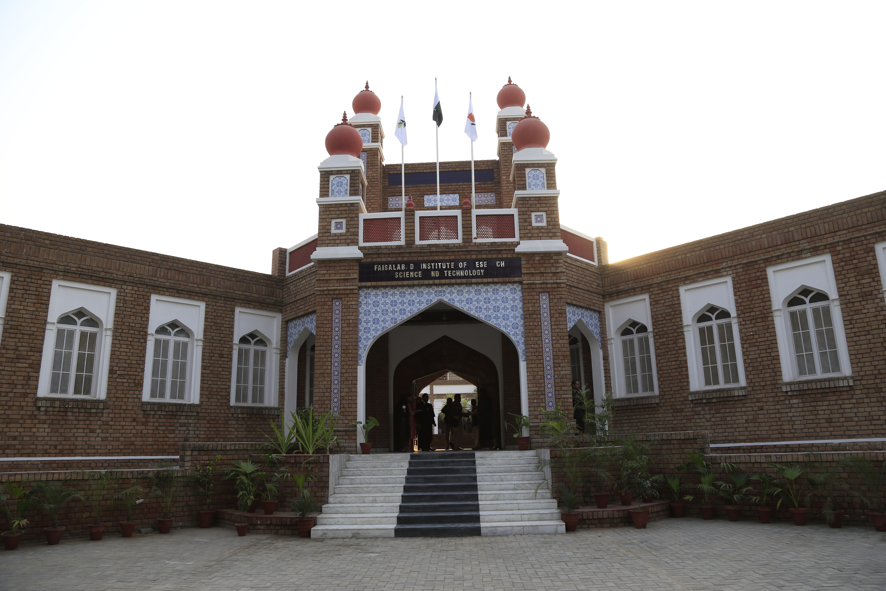

Slide 10
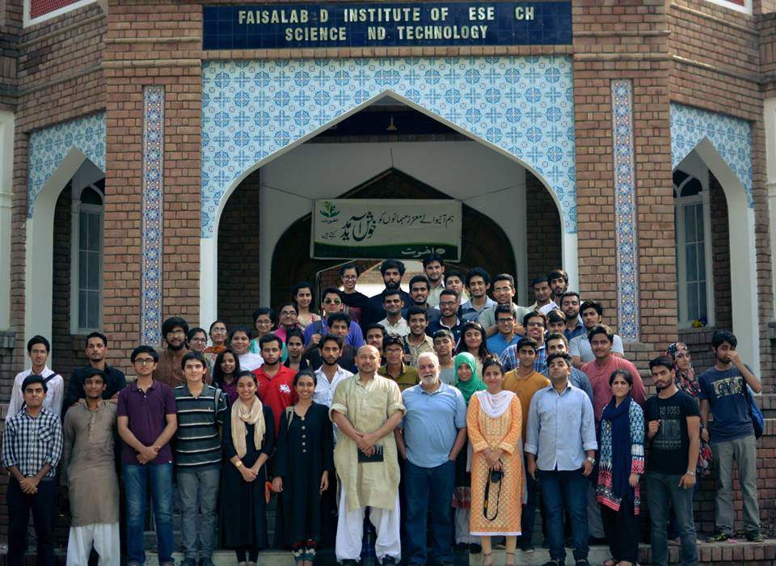
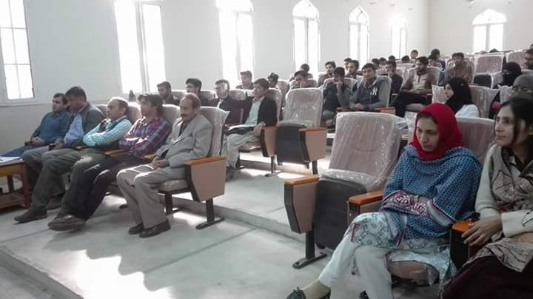

Slide 11
C) Akhuwat University
Akhuwat University promises to transform individual fortunes and have a significant bearing in making a contribution towards making Pakistan stronger and ever more self-confident. It will be a NO FEE UNIVERSITY.

Slide 13
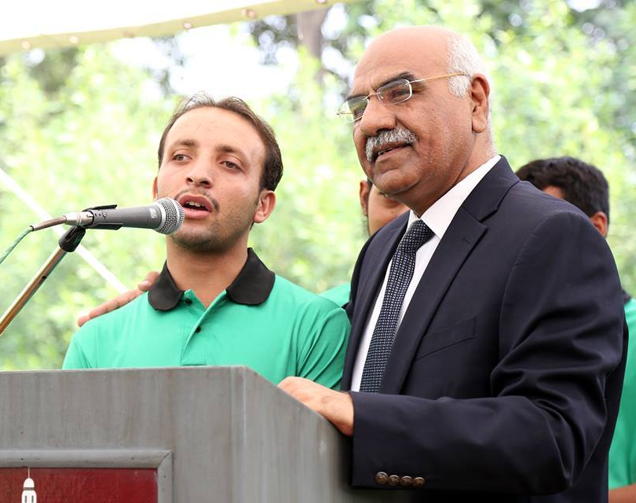
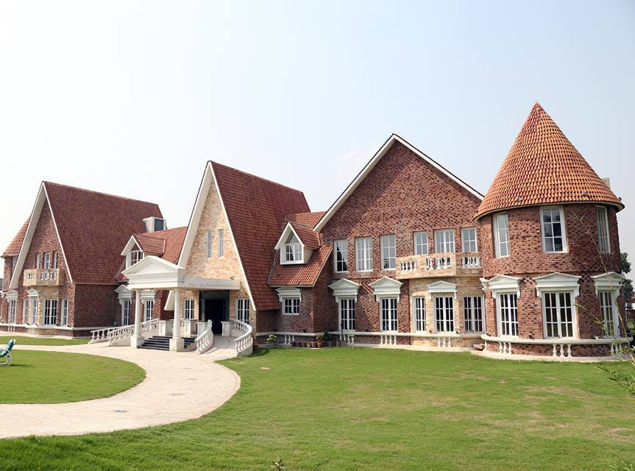
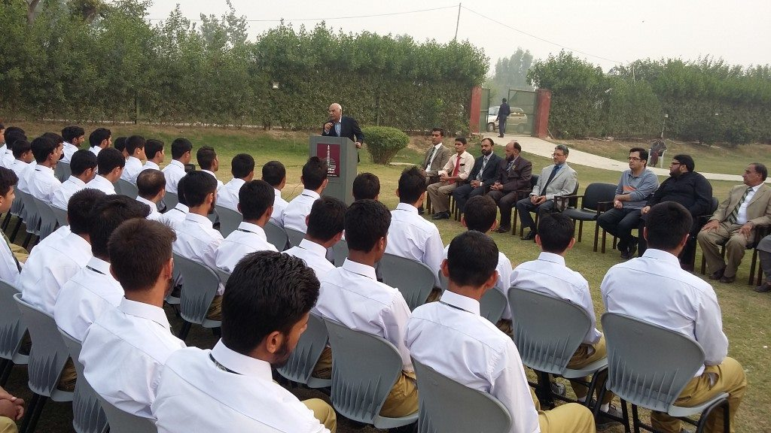
D) Akhuwat College

Slide 14
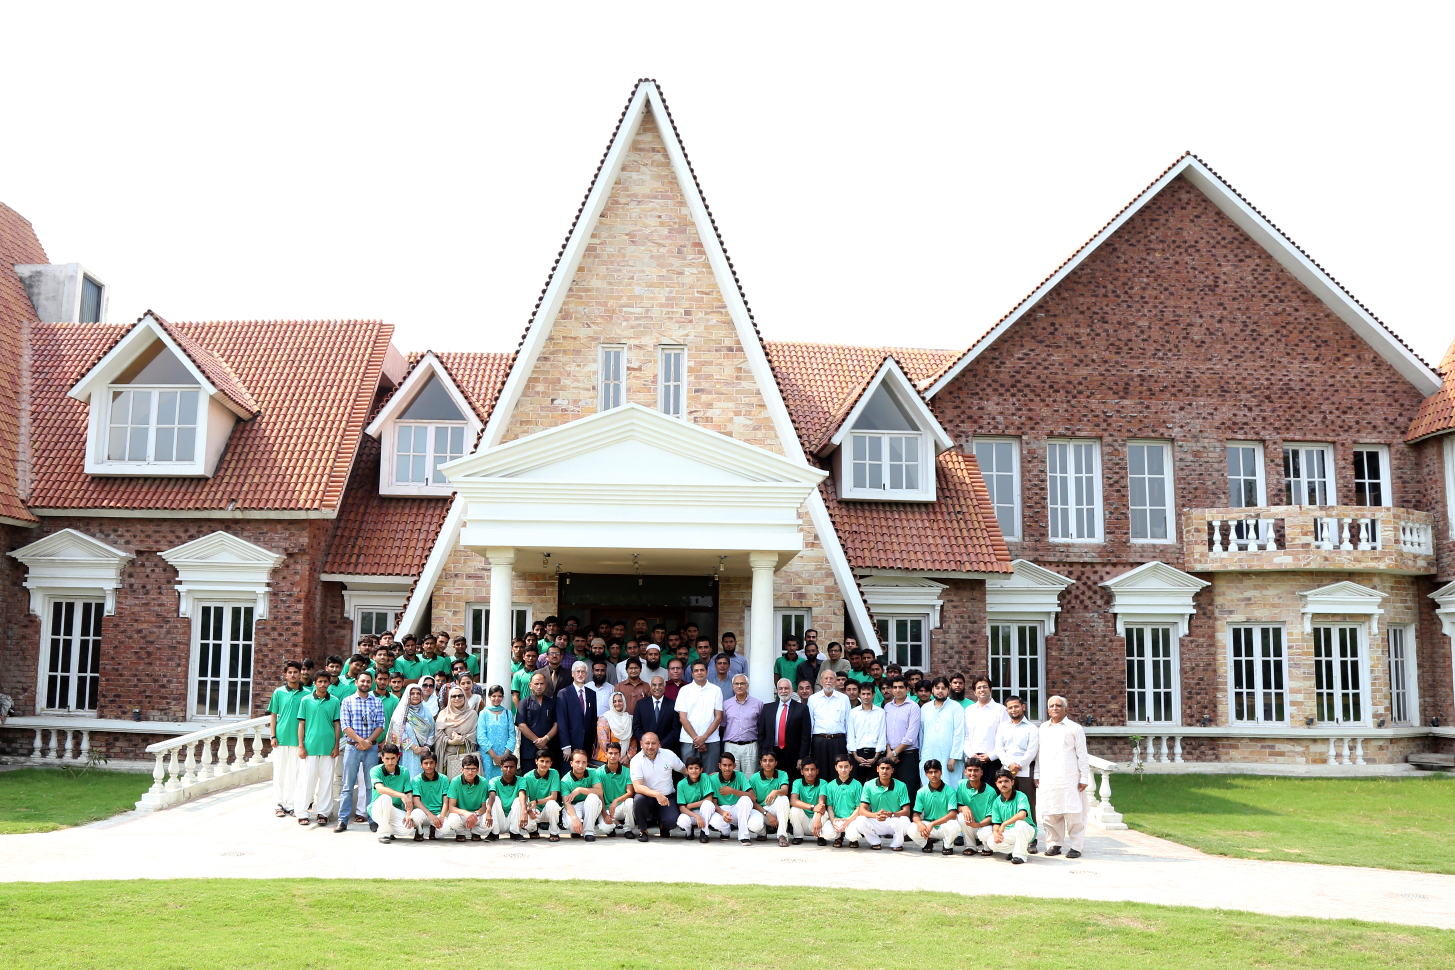
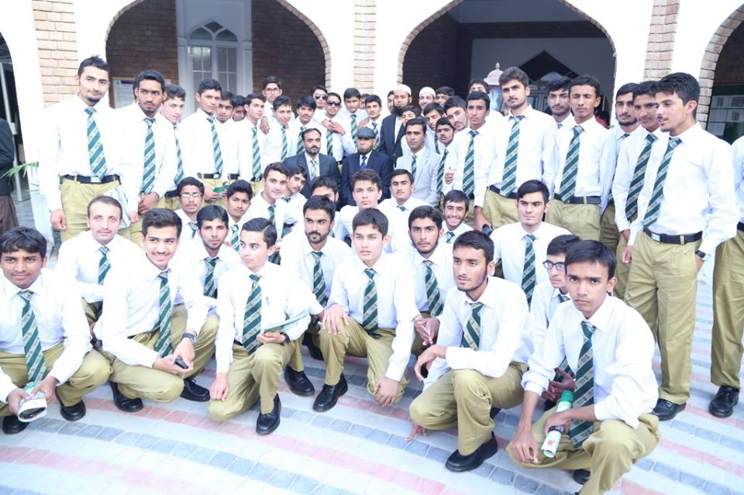
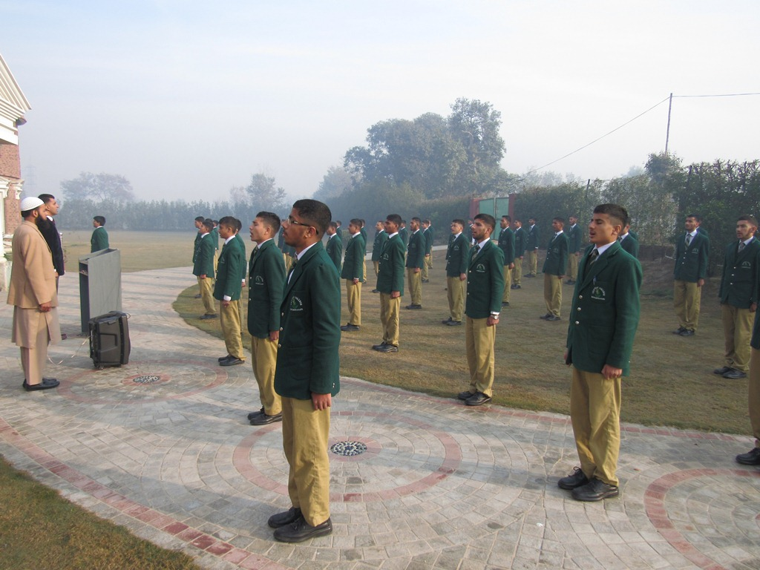
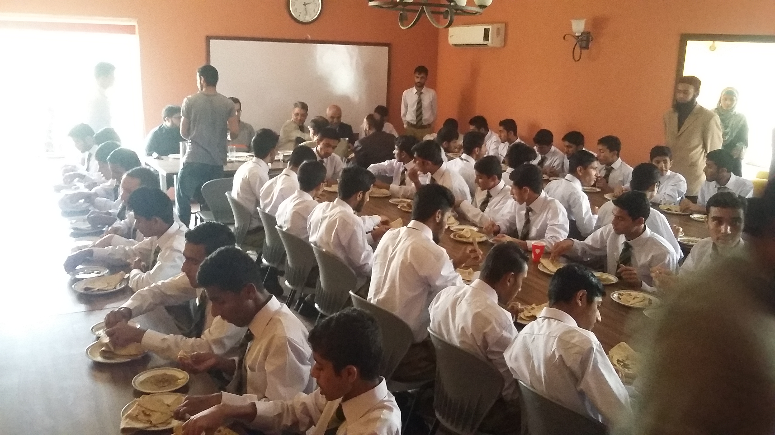

Slide 15
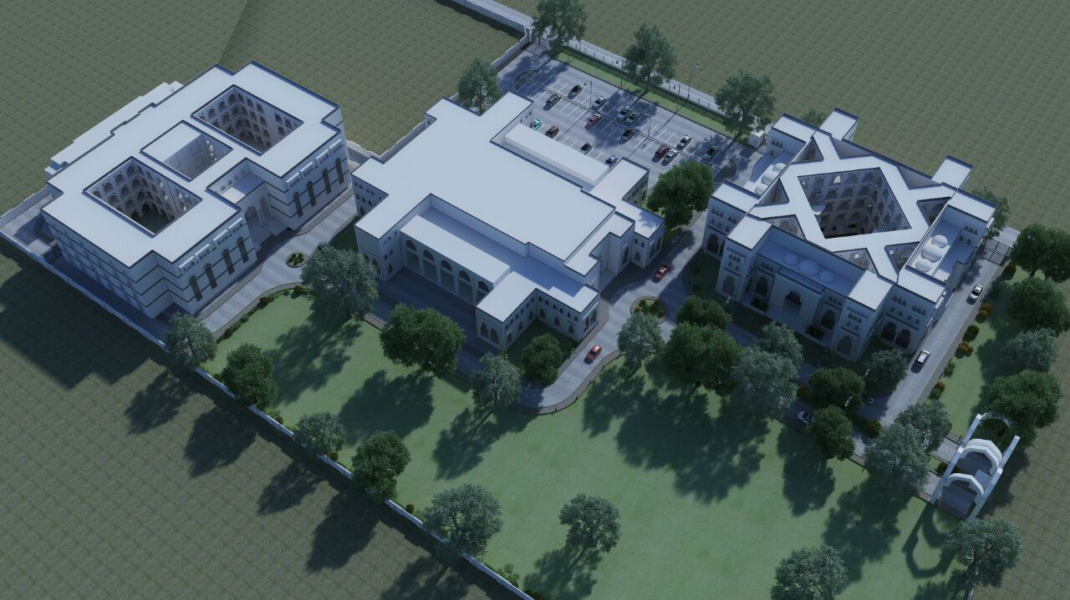

Slide 16
E) Akhuwat Schools

Slide 17
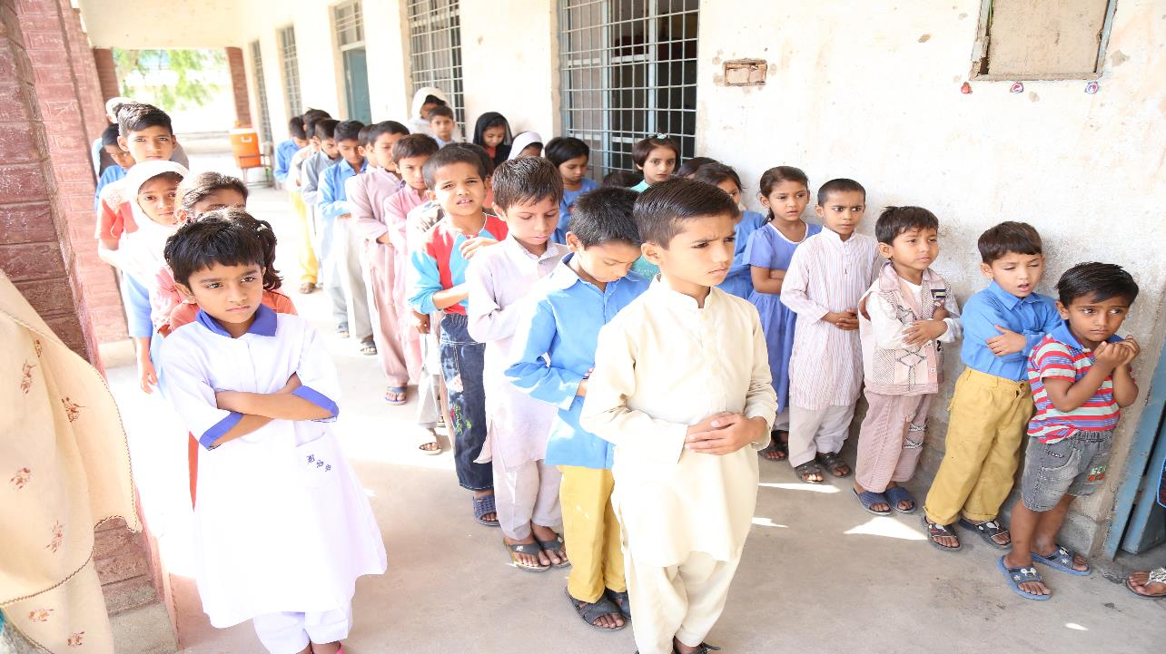
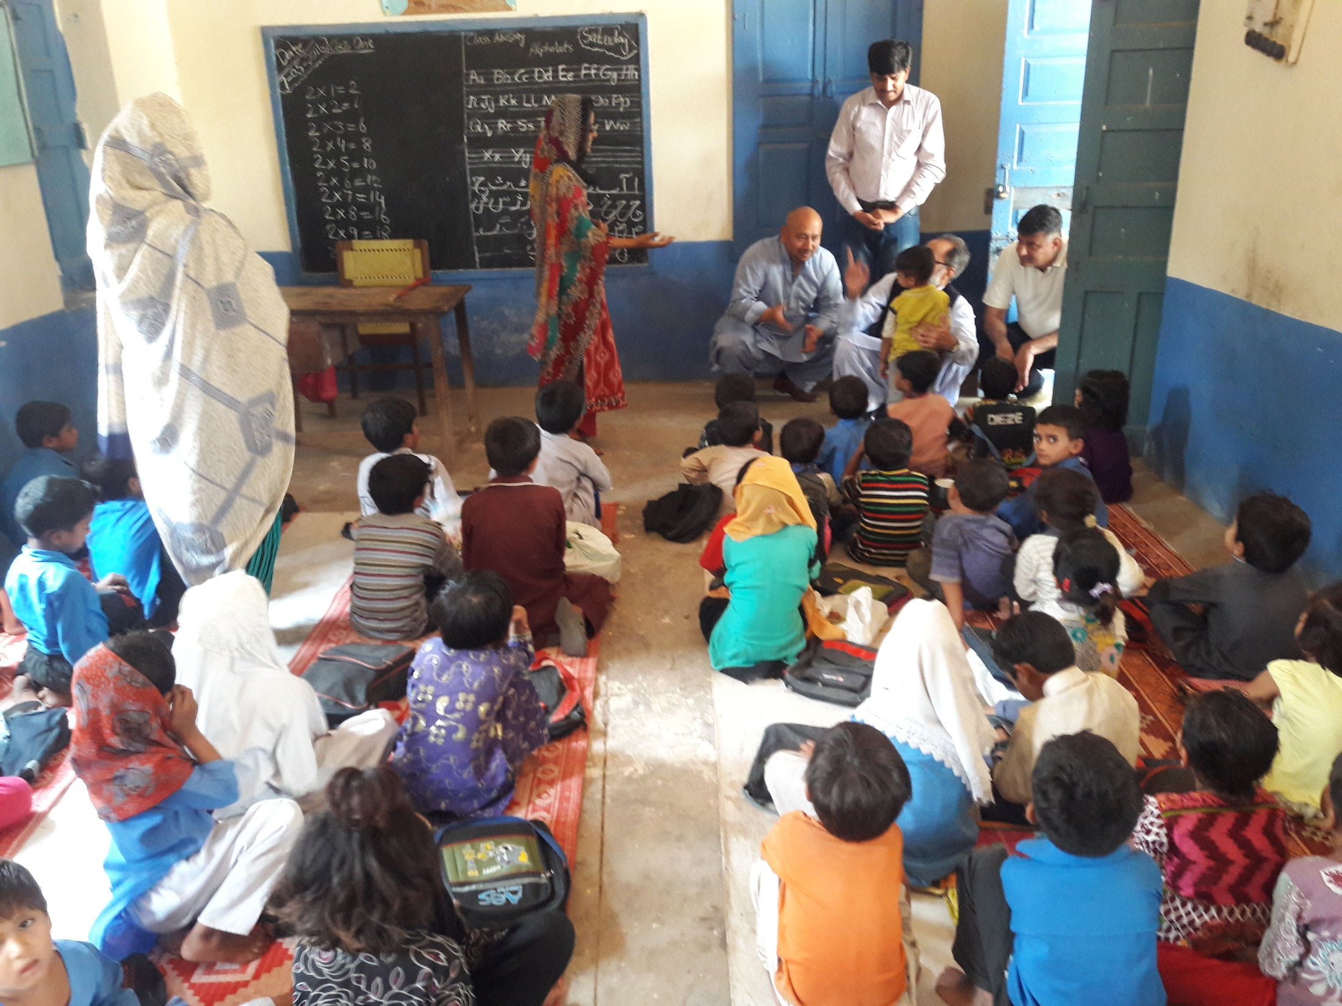
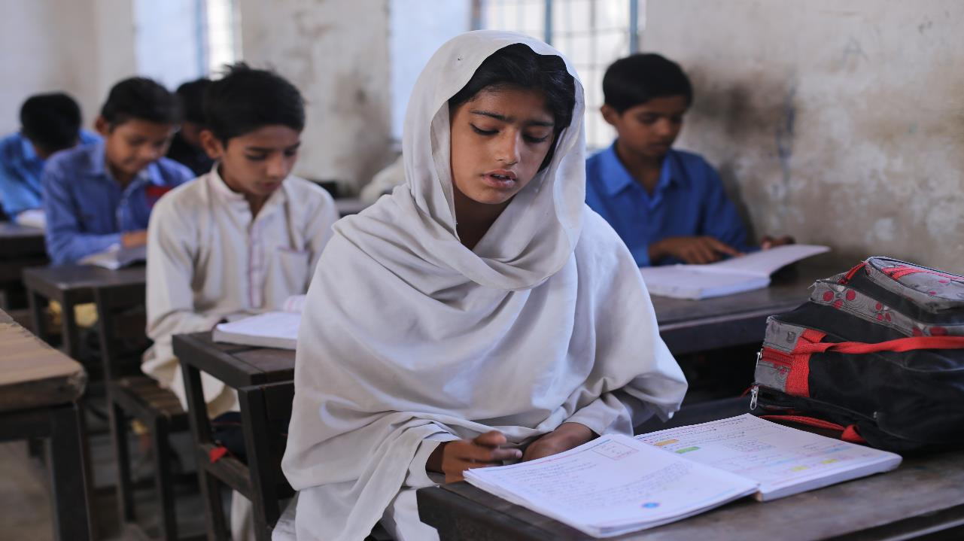
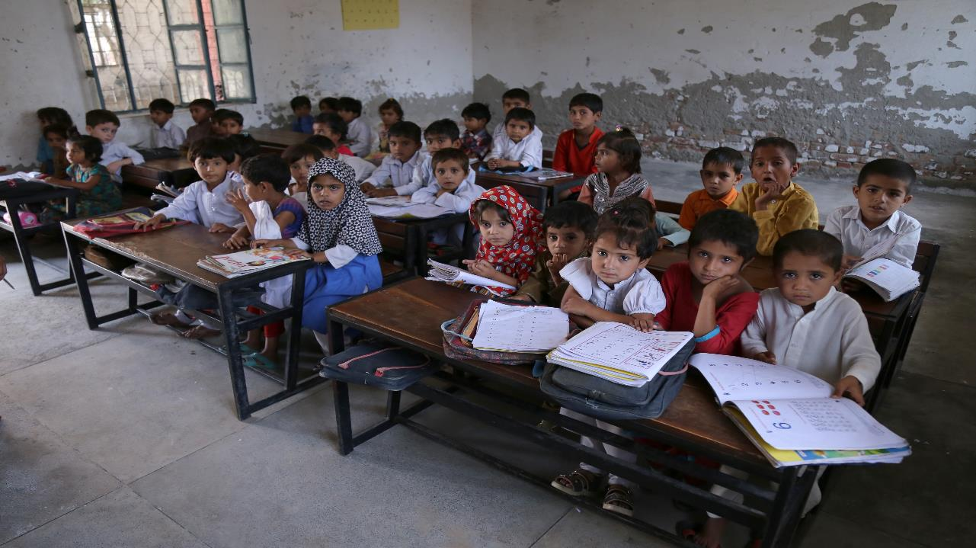
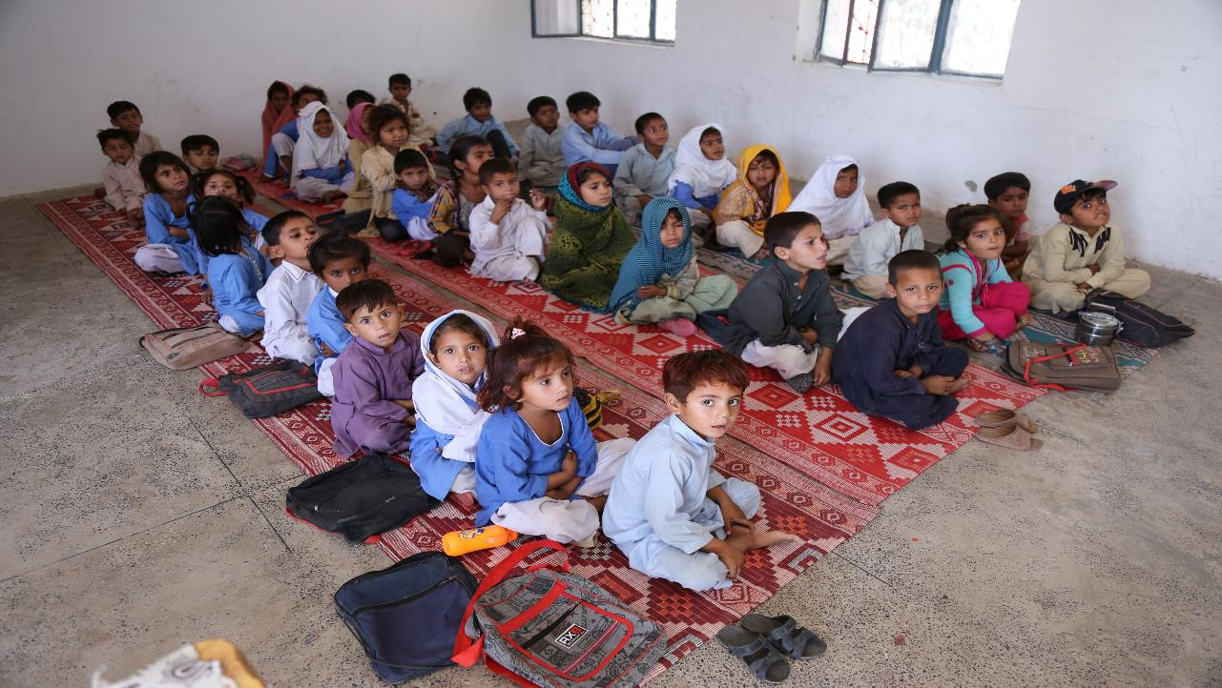

Slide 18
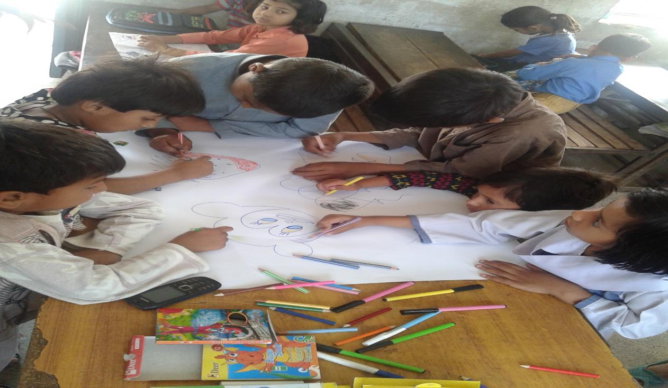
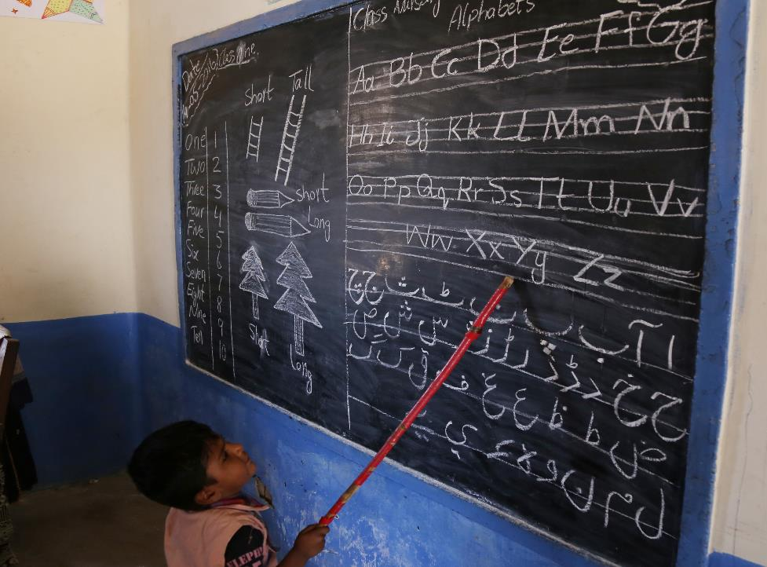

Slide 19
F) Akhuwat Leadership & Fellowship Program
DEVELOPING and NURTURING VALUE BASED LEADERS FOR A BETTER TOMMOROW

Slide 20
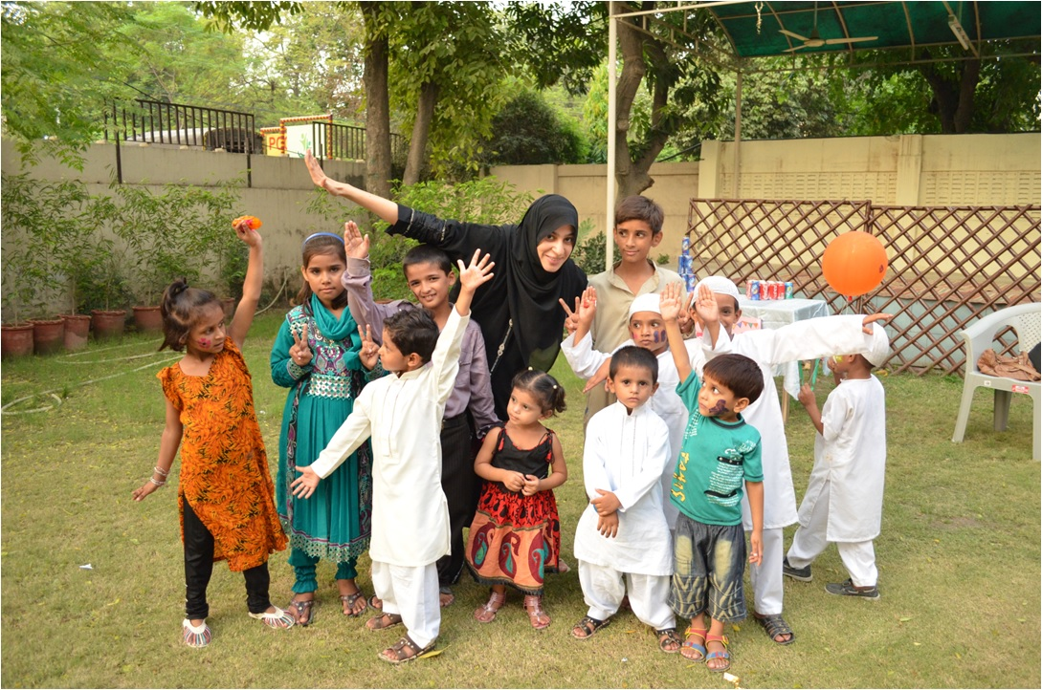
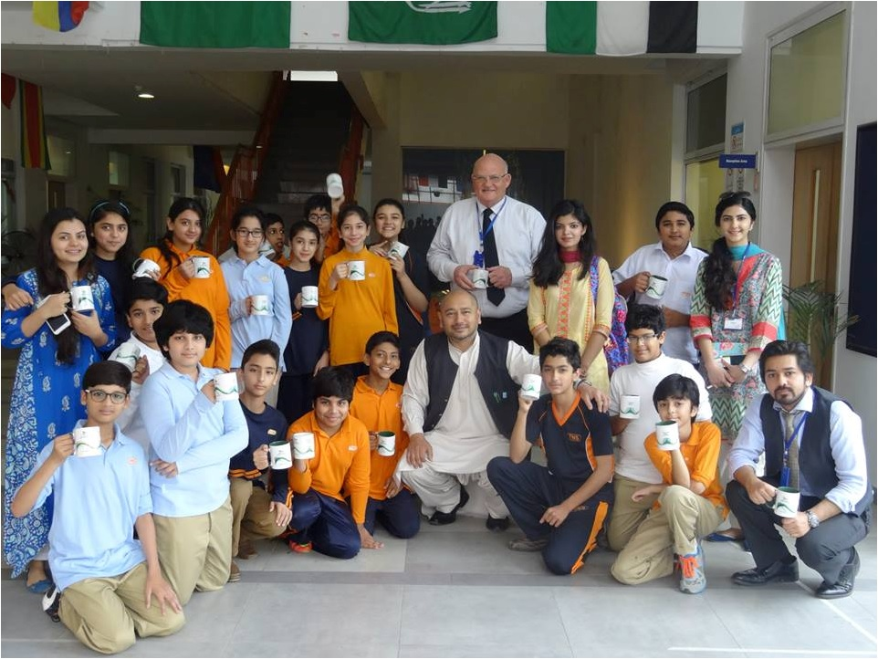
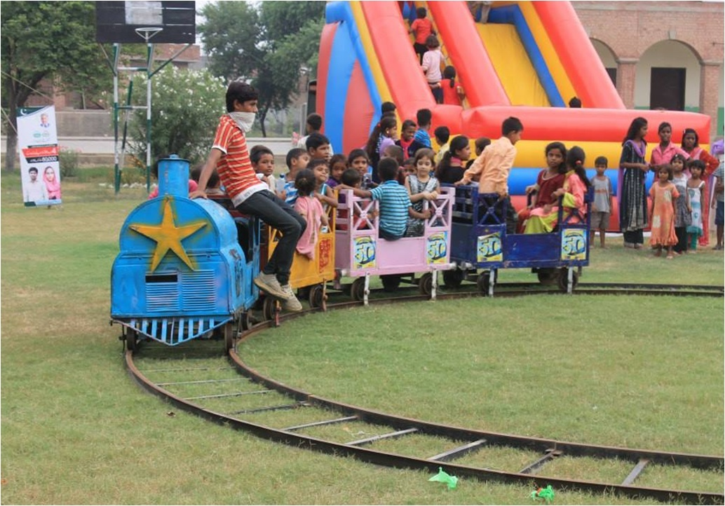
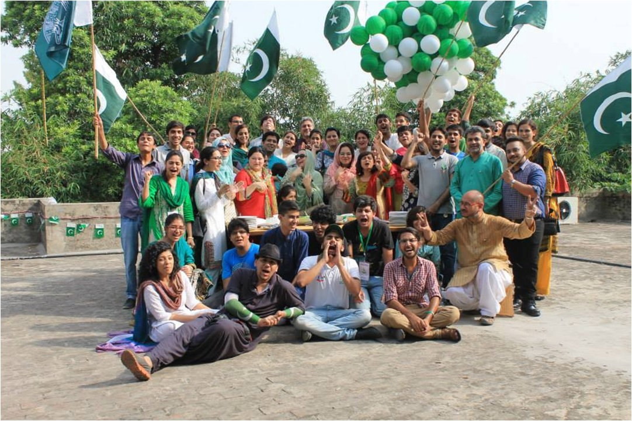

Slide 21
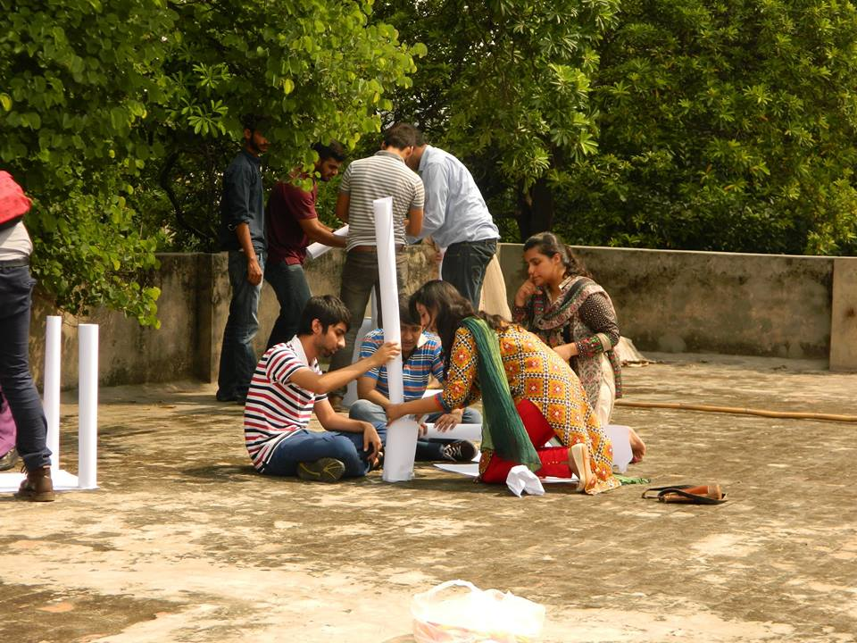
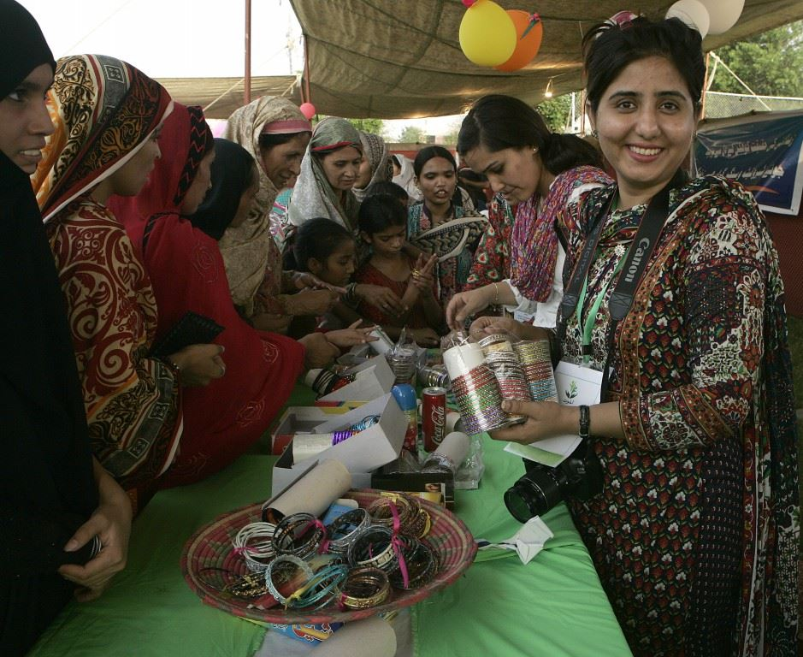
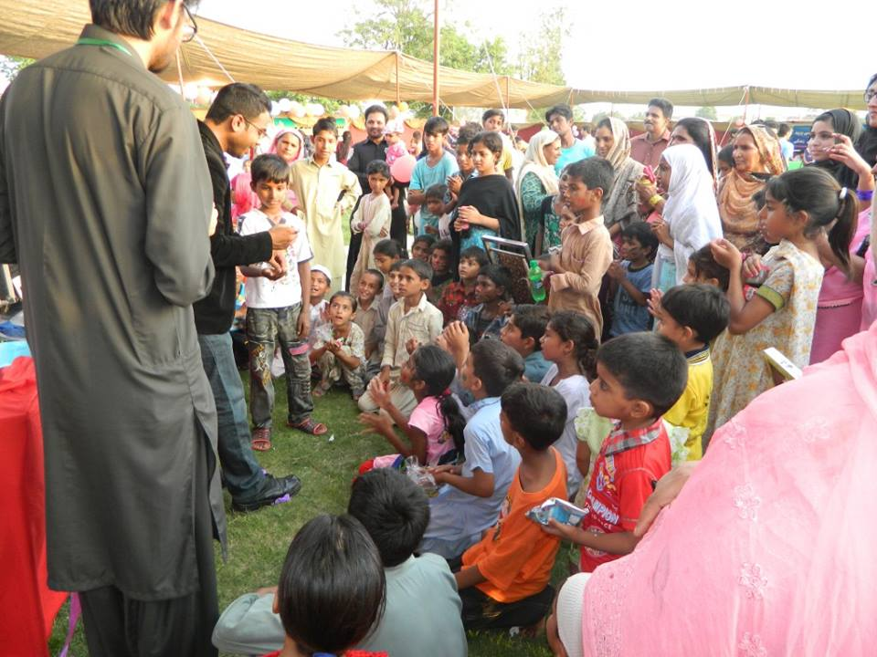

Slide 22
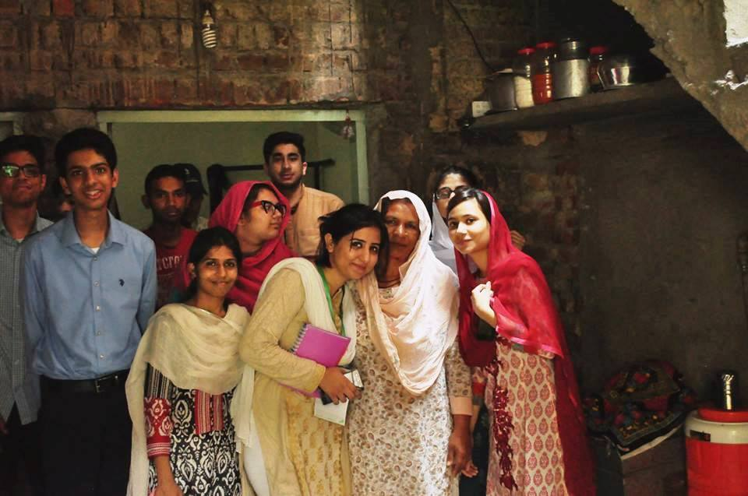
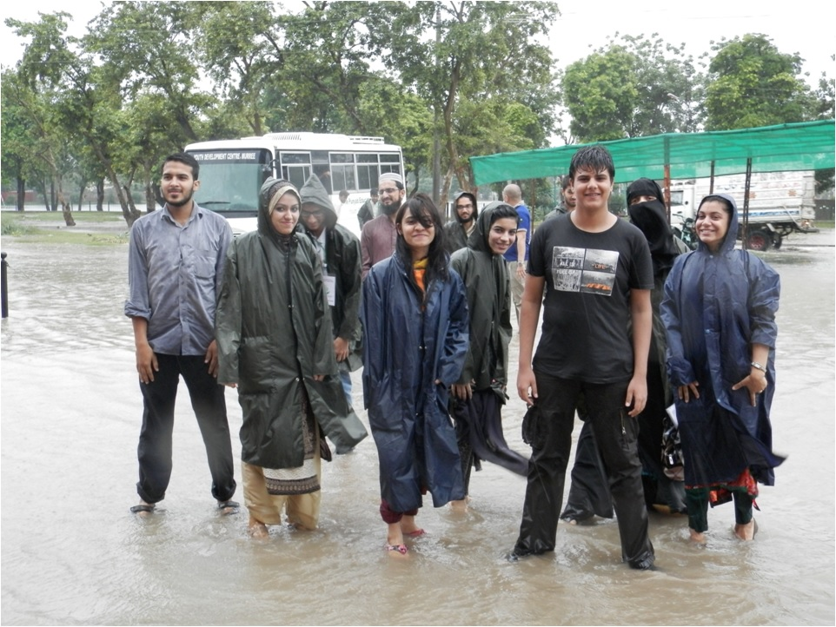
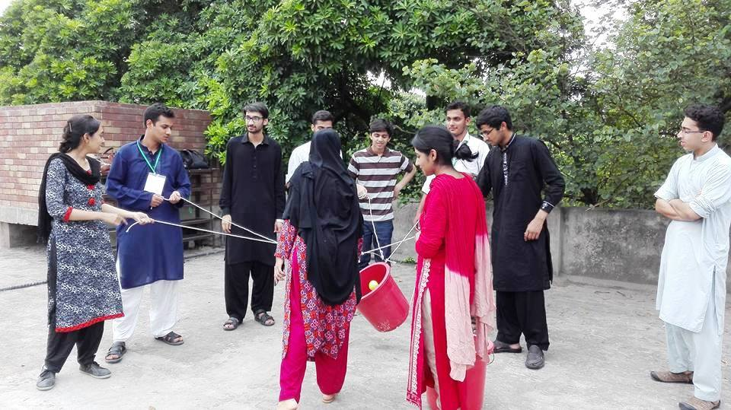

Slide 23
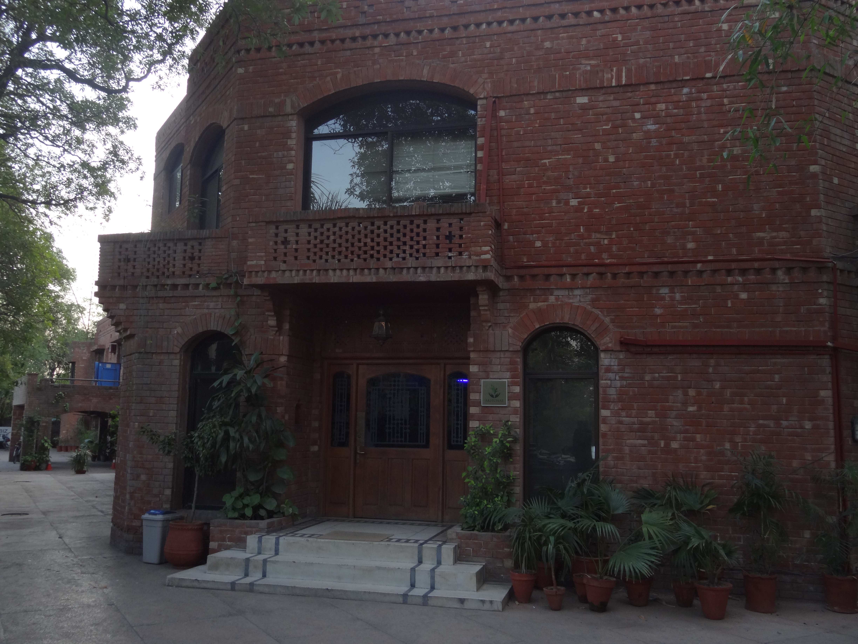
G) Akhuwat Institute of Social Enterprise and Management

Slide 24
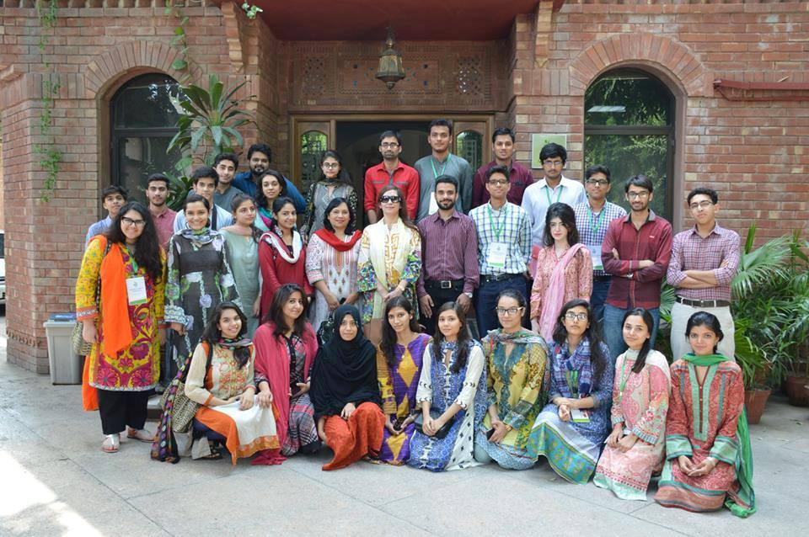
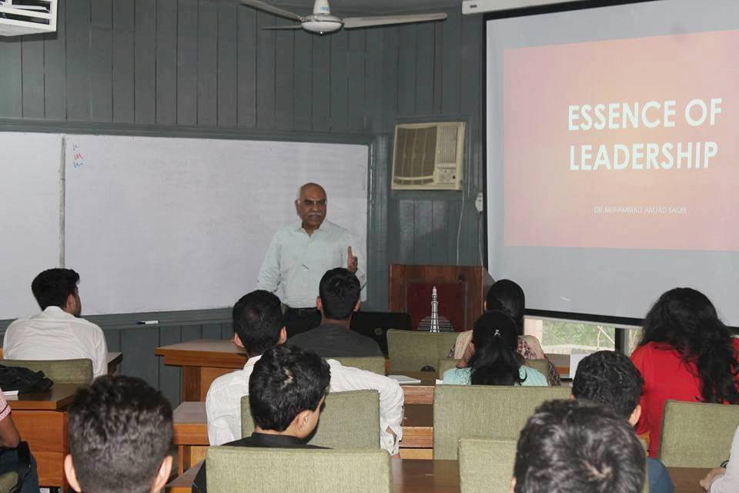

Slide 25
3. Akhuwat Health Services
A center providing state of the art facilities for the treatment and management of Diabetes

Slide 26
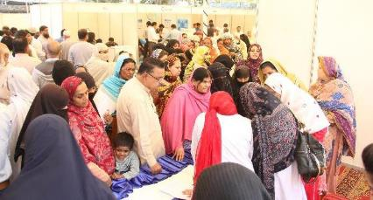
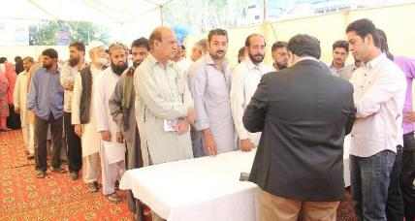
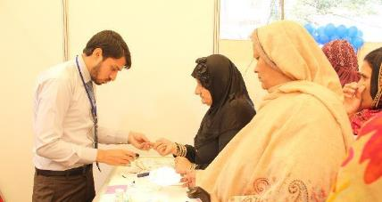
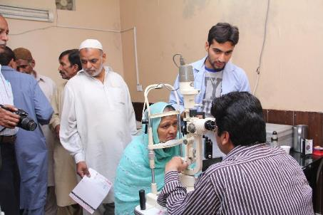
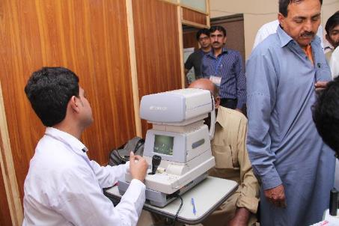
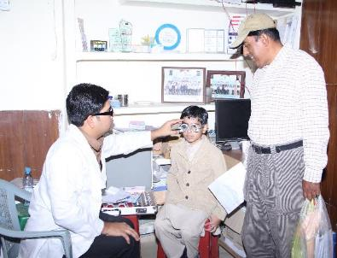
Akhuwat Health Services – Camps

Slide 27
Akhuwat Health Services
Progress till August 2016
Patients treated: 280,000
Approximate contribution: Rs. 2,900,000,000

Slide 28
4. Akhuwat Clothes Bank
Akhuwat Cloth Bank Project is an initiative to raise awareness among the well-to-do families in Pakistan to donate and provide quality used clothes to underprivileged people of Pakistan.

Slide 29
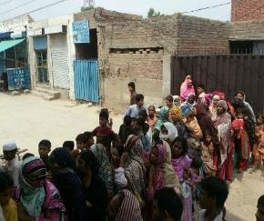
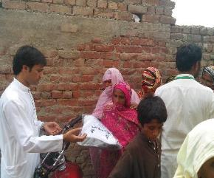
Clothes disbursement in Lahore

Slide 30
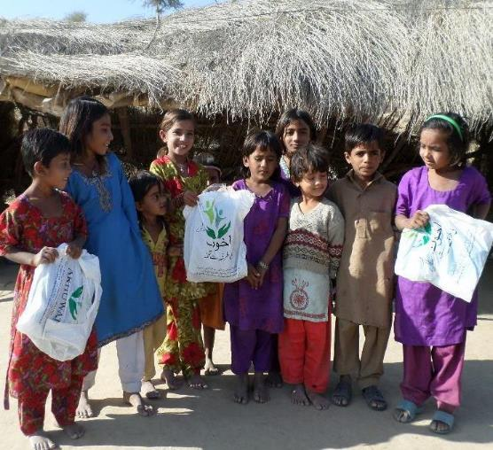
Akhuwat Clothes Disbursement in Mithi - Sindh

Slide 31
5. Akhuwat Khuwajasira Support Program
Goal:
Create a society where the transgendered are treated as equal citizens without prejudice or discrimination.

Slide 32
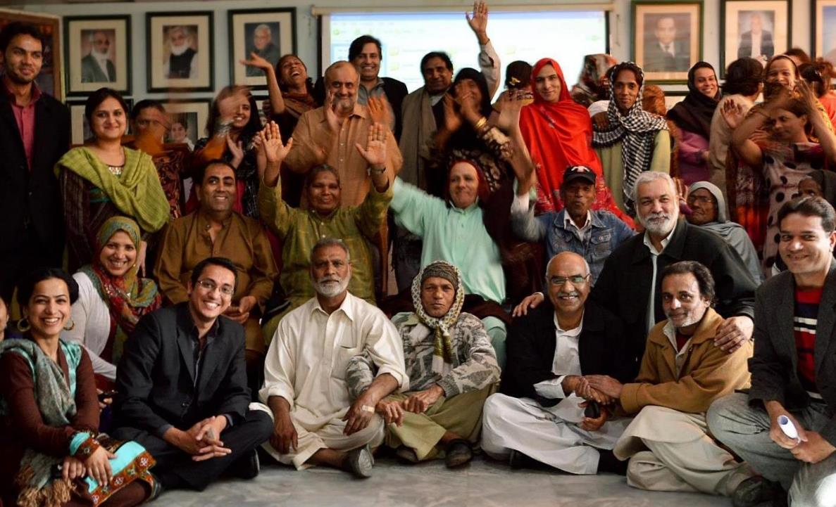

Slide 33
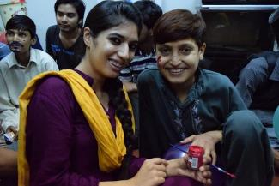
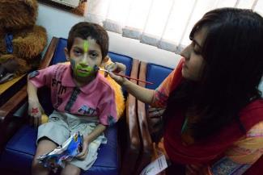
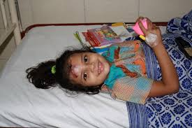
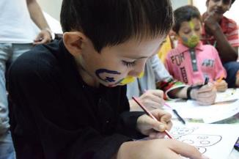
6. Akhuwat Dreams

Slide 34
Akhuwat Dreams

Slide 35
Way Forward
Supporting 2.5 million families by 2020.

Slide 36
Contact Details
Address: 19-Civic Centre, Sector A-II, Near Hamdard Chowk, Township, Lahore www.akhuwat.org.pk
www.aisem.com.pk

